Slide 1
DMV SB251 License and IDs Training
Presented By: Melissa Suit
Notes:
Welcome to SB251 License and IDs Training.

Slide 2

Who qualifies for SB251?
Demonstrate temporary lawful presence
Work, Travel, Education Visas
Employment Authorization Documents
Refugee or Asylum Seekers
Unable to demonstrate lawful presence
Undocumented Immigrants
Notes:
Who qualifies for SB251?
The SB251 Licenses and IDs are for non-US citizens. That means those that are able to demonstrate temporary lawful presence, such as those here on visas, with employment authorization documents, or refugee/asylum seekers, and those that are not able to demonstrate lawful presence, such as undocumented immigrants.

Slide 3
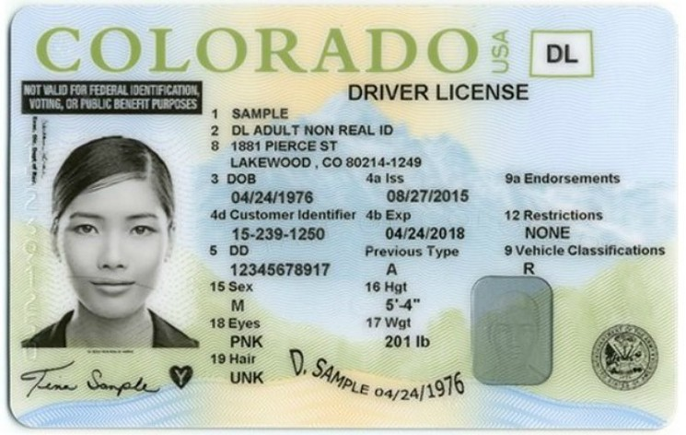

What Licenses and IDs are covered by the SB251 program?
Drivers License and Permits
Identification Cards
Motorcycle Endorsements
Commercial Drivers License
Learning Objectives:
Determine if person qualifies for SB251 program.
Determine what license or ID needed.
What to think about as you listen to the scenarios:
If they qualify?
What license or ID do they need?
Notes:
What Licenses and IDs are covered by the SB251 program?
Both temporary legal immigrants and undocumented immigrants are able to apply for Driver License (minor and adult), Motorcycle Endorsements, and Identification Cards. Only temporary legal immigrants are able to apply for Commercial Drivers Licenses. All Licenses and IDs will be marked with a black banner that says “Not Valid for Federal Identification, Voting or Public Benefit Purposes.”
This leads us into two of our learning objectives for the course: Determining if someone qualifies for the SB251 program and determining what license or ID they would need.
I am going to read you a couple of scenarios that you may experience in your own daily work life. While I do so think about if the person is qualified for the SB251 program and what License or ID they would need.

Slide 4

Scenario 1:
Anna is from England and is studying for a Master’s in Art Design through an Education Visa. She wants to be able to go downtown to the clubs with her classmates. She uses public transportation to get around town.
Anna qualifies for an SB251 ID or Driver’s License.
Notes:
Anna is from England and is studying for a Master’s in Art Design through an Education Visa. She wants to be able to go downtown to the clubs with her classmates. She uses public transportation to get around town.
Yes, Anna is here on a visa so she can demonstrate a temporary lawful presence needed to get an identification card or a driver’s license.

Slide 5

Scenario 2:
Ross was born in Mexico and is 20 years old. He wants to be able to drive his fellow farm-workers to the job site. He works as part of a migrant working group that travels from Mexico to work the harvest season before returning home.
Ross qualifies for the program to get a Driver’s License, would need more information for a Commercial Drivers License.
Notes:
Ross was born in Mexico and is 20 years old. He wants to be able to drive his fellow farm-workers to the job site. He works as part of a migrant working group that travels from Mexico to work the harvest season before returning home.
Yes, Ross is not a US citizen. Based on the information given in the scenario you are not able to determine if he is able to demonstrate a temporary lawful presence or not. He would still qualify for a driver's license but potentially not a Commercial Drivers License.

Slide 6

Scenario 3:
Mia has dual citizenship in Canada and the US. She is 15 and is ready to start driving.
Mia does not qualify for an SB251 minor driver’s license.
Notes:
Mia has dual citizenship in Canada and the US. She is 15 and is ready to start driving.
No, Mia has US citizenship so she will get to go down another route to get her minors driver’s license.

Slide 7
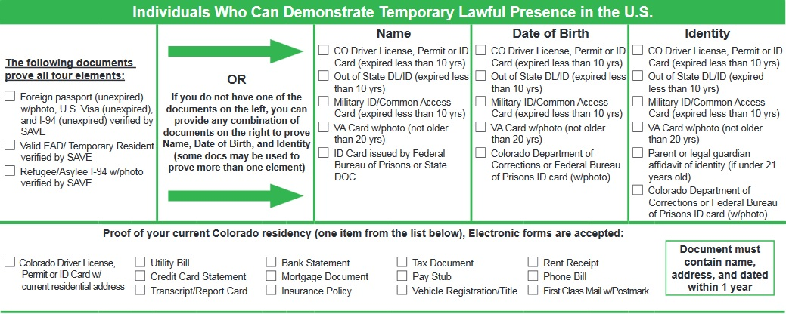
Required Documents: Temporary Legal Immigrants
Notes:
Since the documents that are needed are different for each category let's divide them up. Let’s start with those that are temporary legal immigrants. Go ahead and open your pamphlet to the right. You should see a section titled “Required Documents for Temporary Legal Immigrants.” Temporary legal immigrants need to provide proof of name, date of birth, identity, and current Colorado residence. Each category shows which documents would be accepted as proof. For Name, Date of Birth, and Identity there are a couple of documents that provide all of this information that can be found in the top left-most box.

Slide 8
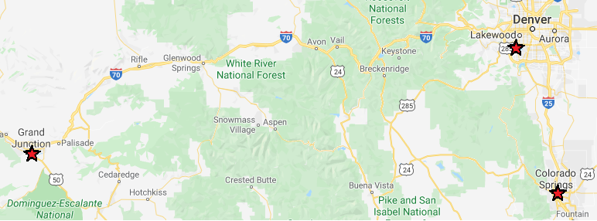
3 DMVs Able to Process SB251 Applications for Undocument Immigrants
Notes:
Now let’s go over what is needed for undocumented immigrants. Close your pamphlet so you are looking at the flow chart, then open it to the left. You should see 2 sections with a list of DMVs at the top. These are the three DMVs that are able to process SB251 applications for Undocumented Immigrants. They are located in Westgate, Grand Junction, and Colorado Springs.

Slide 9
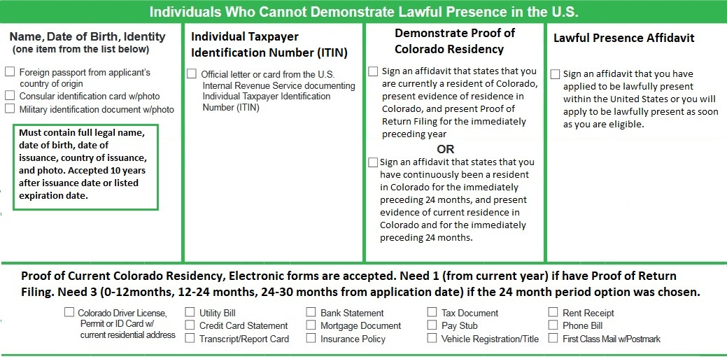
Required Documents: Undocumented Immigrants
All Documents need to be in English.
Notes:
Below the DMVs is the list of required documents. Undocumented immigrants have to provide proof of name, date of birth, identity, individual taxpayer identification number (ITIN), and demonstrate proof of Colorado Residency. An additional requirement for undocumented immigrants is the requirement to sign an affidavit claiming they applied to be lawfully present within the US or that they will do so as soon as they are eligible. The DMV provides these affidavits. Let’s take a moment to look at the Demonstrate Proof of Colorado Residency requirement as it can be a bit tricky. There are two options for this requirement. The first is to sign an affidavit claiming you are a current resident, provide 1 piece of proof from the bottom box, and also provide Proof of Return Filings aka tax returns. The other option is to sign an affidavit claiming you have been a resident for 24 months, then provide 3 pieces of proof from the bottom box, 1 from each correct date range (0-12 months, 12-24 months, and 24-30 months). A common question that gets asked about the required documents is if they need to be in English. The answer is yes they must be translated to English before the appointment as the DMV does not offer translation services. The original document must also be present.

Slide 10
Scenario 1:
Learning Objectives:
Identifying which documents an applicant needs.
Anna was our student here on an Education Visa and she was looking to get an ID card. She has her Passport issued by England and her U.S. Visa. What else would she need?
1 piece of proof of current Colorado Residency
Ideally her I-94 form
Notes:
Now let’s tackle our final learning objective for this training. Identifying which documents an applicant will need. Let’s revisit our two scenarios from earlier.
Anna was our student here on an Education Visa and she was looking to get an ID card. She has her Passport issued by England and her U.S. Visa. What else would she need?
Anna needs 1 piece of proof of current Colorado Residency, and ideally her I-94 form.

Slide 11
Scenario 2:
Ross was our migrant worker from Mexico who wanted to get a Drivers License. Upon further questioning, you discover that he does not have a visa or employment authorization documents, meaning he is unable to demonstrate lawful presence. He has his Mexico passport, tax filings from the previous year, and an ITIN card. What else does he need?
Sign the lawful presence affidavit
Provide 1 piece of proof of current Colorado Residency.
Notes:
Ross was our migrant worker from Mexico who wanted to get a Drivers License. Upon further questioning, you discover that he does not have a visa or employment authorization documents, meaning he is unable to demonstrate lawful presence. He has his Mexico passport, Tax filings from the previous year, and an ITIN card. What else does he need?
Ross needs to sign the lawful presence affidavit and provide 1 piece of proof of current Colorado Residency.

Slide 12

Wrap-Up
Learning Objectives
Determine if person qualifies for SB251 program.
Determine what license or ID needed.
Identifying which documents an applicant needs.
Customer Service Oriented
Are there any Questions
Notes:
That wraps up the SB251 License and IDs training. By now you should be able to: determining if someone qualifies for the SB251 program, determining what license or ID they would need, and identifying which documents an applicant will need.
Something to keep in mind is that while this training covered the material and content you need to successfully handle SB251 license and ids, it did not cover the customer service challenges that come with this program. Please remember that you are the face of the DMV and that we are customer service oriented. It’s important to handle all situations with a smile and by being polite. If you feel like you are unable to control a situation and an applicant is becoming frustrated and rude do not hesitate to ask for assistance from your manager.
Are there any questions?

